Slide 1

Jquery

Slide 2
Outline
Jquery
Usable framework for javascript
DOM
Jquery vs Javascript
Syntax
Selector & action
examples

Slide 3
Jquery
“jQuery is a fast, small, and feature-rich JavaScript library.
It makes things like HTML document traversal and manipulation, event handling, animation, and Ajax much simpler with an easy-to-use API that works across a multitude of browsers. With a combination of versatility and extensibility,
jQuery has changed the way that millions of people write JavaScript.”

Slide 4
Jquery
Jquery is one of the most important JavaScript frameworks.
The most important features are:
Lightweight footprint: Only 30kB minified.
Excellent DOM manipulation
Cross-browser compatibility: Chrome, Edge, Firefox, IE, Safari, Android, iOS, and more
CSS3 compliant: Supports CSS3 selectors to find elements as well as in style property manipulation
Great Open Source Software (OSS) support

Slide 5
DOM Document Object Model
"The W3C Document Object Model (DOM) is a platform and language-neutral interface that allows programs and scripts to dynamically access and update the content, structure, and style of a document.“ W3C (World Wide Web Consortium)

Slide 6
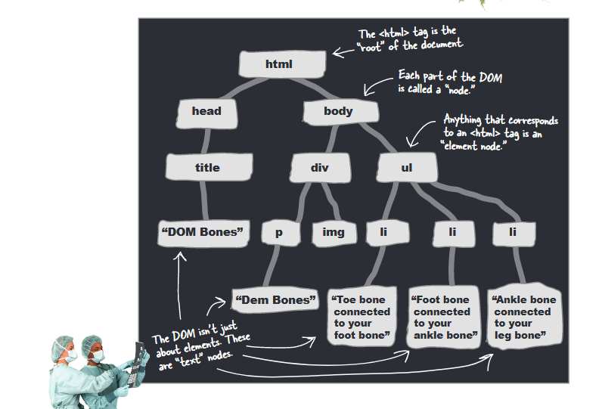
DOM Document Object Model

Slide 7

DOM Document Object Model

Slide 8
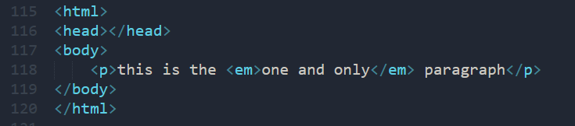
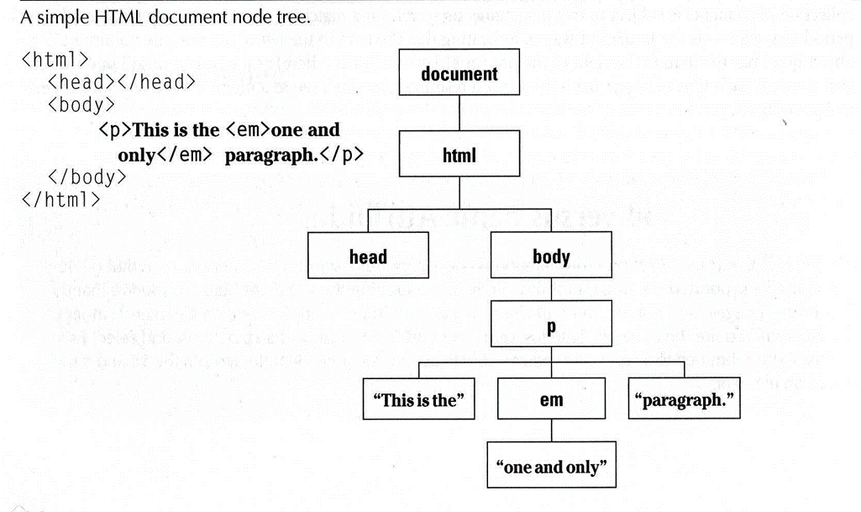
DOM Document Object Model

Slide 9
DOM & JQuery
jQuery is “DOM scripting”
Heirarchal structure of a web page
Jquery can add and subtract DOM elements on the fly
Jquery can change the properties and contents of DOM elements on the fly

Slide 10
Jquery Core Function
Find and Select DOM (Document Object Model) element/s on a page (p, div, footer, li, etc)
Set properties of DOM element/s
Creates, deletes, shows, hides DOM elements
Defines event behavior of element (click, mouse movement, dynamic styles, animations)
AJAX

Slide 11
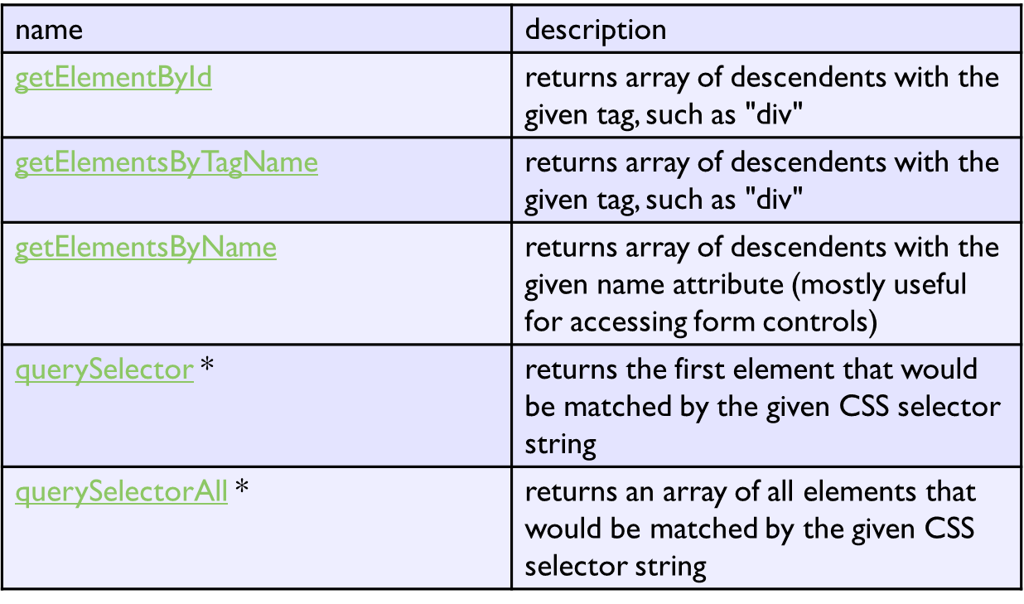
Selecting groups of DOM objects

Slide 12
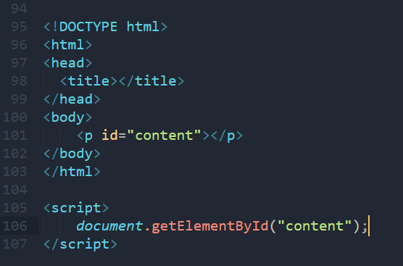
Selecting groups of DOM objects

Slide 13
JQuery
. . .
<script src="jquery-3.3.1.min.js"> </script>
<script src="https://ajax.googleapis.com/ajax/libs/jquery/3.3.1/jquery.min.js"></script>
. . .
$(document).ready(function(){ $(“.sidebar").click(function(){ $(this).hide(); }); });

Slide 14
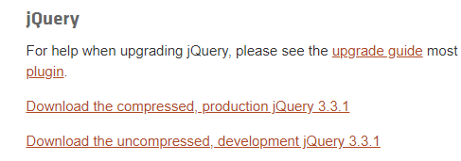
Type file of JQUERY
Production (compressed)
Development (uncompressed)

Slide 15
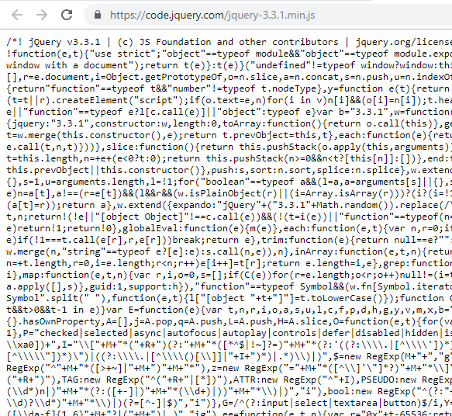
Type file of JQUERY
Compressed or minified

Slide 16
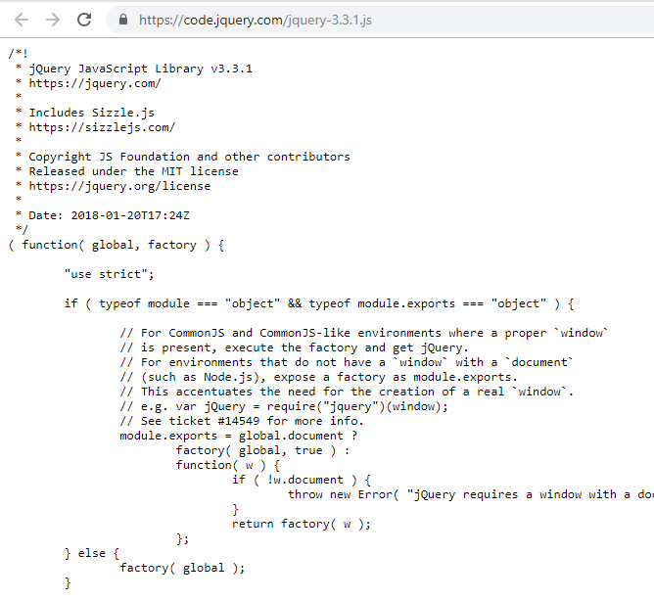
Type file of JQUERY
Uncompressed

Slide 17
Jquery Syntax
$(selector).action()
$ is jQuery keyword
(selector) to "query (or find)" HTML elements/DOM
action() to be performed on the element(s)

Slide 18
Jquery selector
$(selector).action()
element Selector (div, p, span, ul, li, table, tr, td, and so on..)
#id Selector
.class Selector

Slide 19
Jquery selector
element Selector
$("p") $(“div”) $(“footer”)
#id Selector
$(“#sidebar") $(“#users”) $(“#img_pro”)
.class Selector
$(“.data-list") $(“.menu”)

Slide 20
Jquery Simple Example
$(document).ready(function(){ $(“#sidebar").click(function(){ $(this).hide(); });
$(“footer”).show();
$(“#sidebar").click(function(){ $(this).hide(); }); });

Slide 21
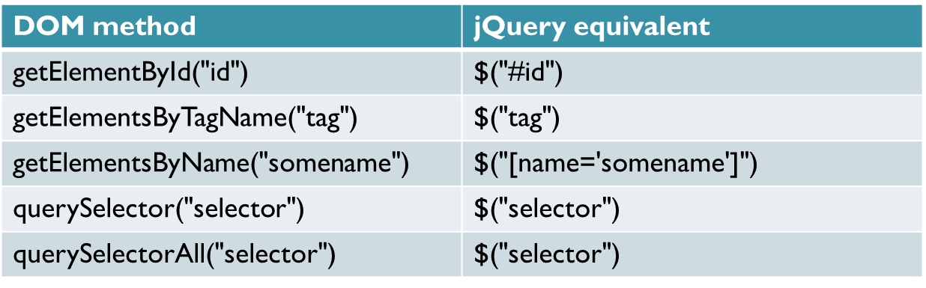
Native Javascript vs JQuery

Slide 22
Jquery event
click()
dblclick()
mouseenter()
mouseleave()
hover()
focus()
blur()
on()
Etc…

Slide 23
Jquery Action
hide()
show()
addClass()
fadeIn()
fadeOut()
fadeToggle()
toggle()
slideUp()
slideDown()
slideToggle()
append()
remove()

Slide 24
Examples

Slide 25
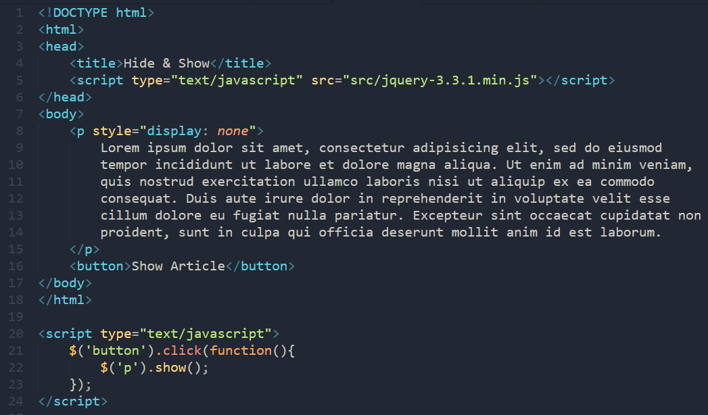
Hide & Show

Slide 26
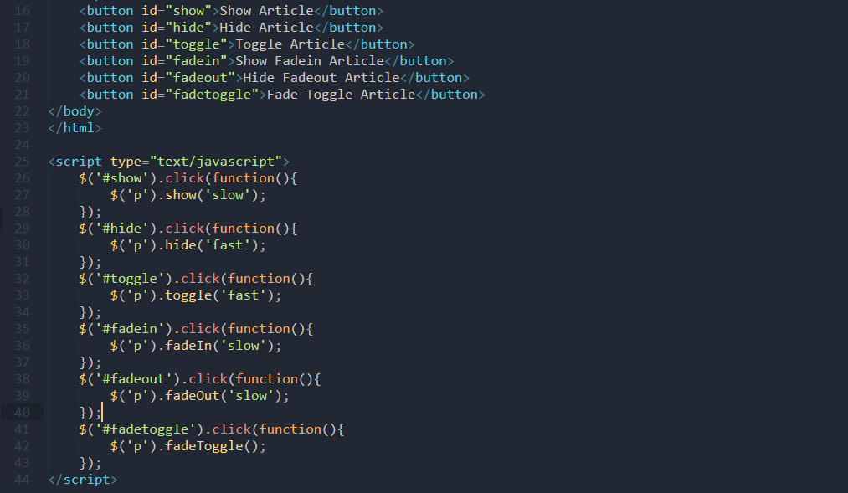
Toogle, FadeIn, FadeOut, FadeToggle

Slide 27
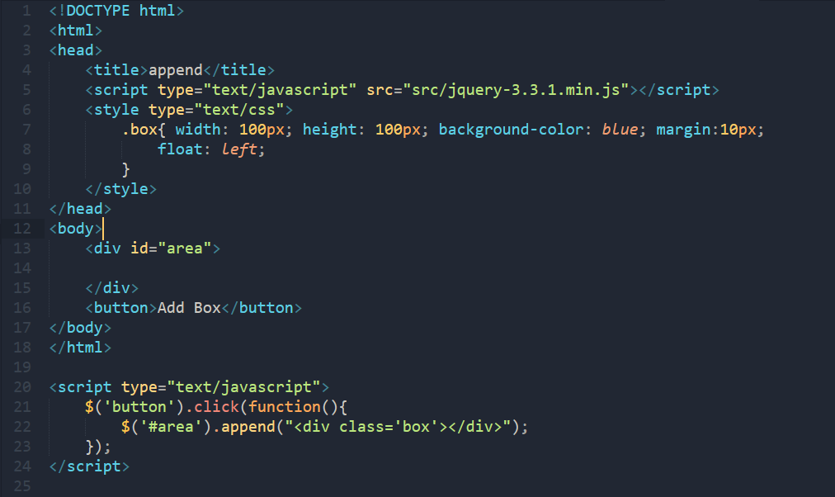
Append

Slide 28
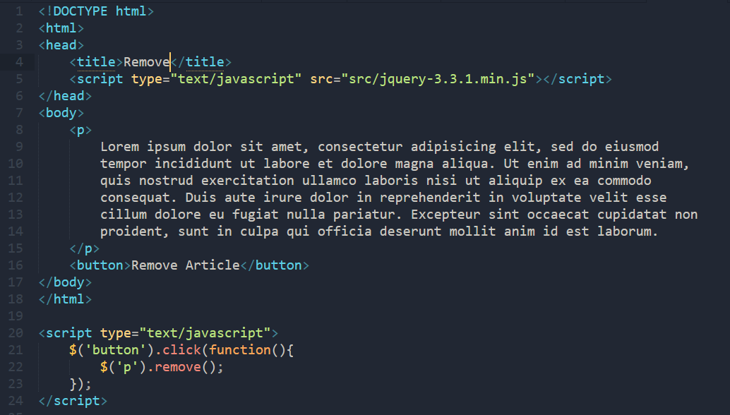
Remove

Slide 29
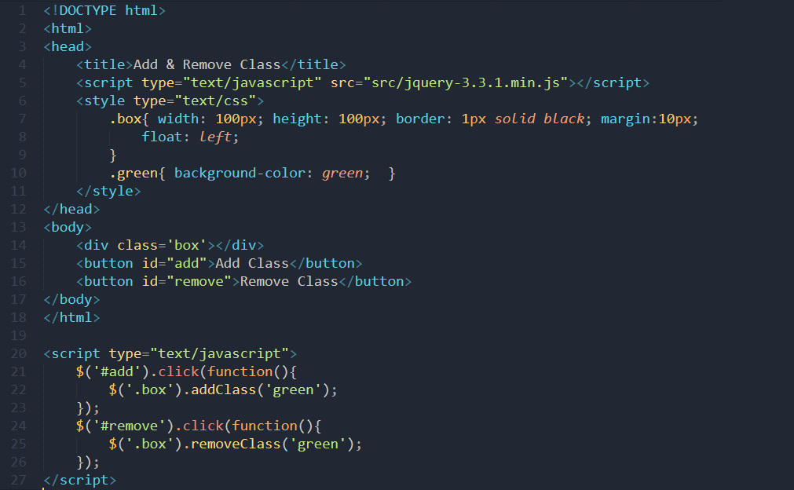
addClass & removeClass

Slide 30
Jquery
Current version : v3.3.1
https://jquery.com/
Documentation: https://api.jquery.com/
http://learndown.com/en/download-30-days-to-learn-jquery/

Slide 31
Reference
Head First jQuery, O’Reilly, 2011
Jquery.com
w3schools.com/jquery/

